Slide 1
Thinkuknow parents and carers presentation
(secondary)
Protect your children from sexual abuse online
www.thinkuknow.co.uk/parents
Notes:
Note to presenter: Please read through the presentation thoroughly before delivery and familiarise yourself with the Thinkuknow websites (www.thinkuknow.co.uk) and CEOP Safety Centre (www.ceop.police.uk) if needed. There are delivery notes and instructions in italics on some slides to aid your delivery.
Introduce yourself and your role to your audience.
This presentation has been developed by the CEOP Education Team at the National Crime Agency (NCA). Thinkuknow is the national education programme from NCA-CEOP, dedicated to keeping children safe from sexual abuse and exploitation both online and offline.
NCA-CEOP is a multi-disciplinary child protection centre, staffed by law enforcement officers, social workers, education officers, intelligence officers, child psychologists and many more.
Parents should visit www.thinkuknow.co.uk/parents (on screen) for further information and advice on supporting their child to be safe online. Please encourage your audience to look at the website after this session as it has lots more information on how they can protect their child online

Slide 2
This presentation will cover:
Young people online
Sexual exploration online
Sharing images
Sexual abuse online
What can you do?
Thinkuknow resources for secondary
Thinkuknow resources for parents and carers
Reporting to NCA-CEOP
Notes:
This presentation will cover:
Young people online – The impact of growing up online
Sexual exploration online – How young people use the internet to explore relationships and sex
Sharing images online – Different teen motivations to share sexual images online
Sexual abuse online – The risk of young people being contacted by adults who want to harm them
What can you do? Advice for parents and carers
Thinkuknow resources for secondary aged children
Thinkuknow resources for parents and carers
Reporting to NCA-CEOP – Children and young people, as well as their parents and carers, can report directly to CEOP if they are concerned about CSAE

Slide 3
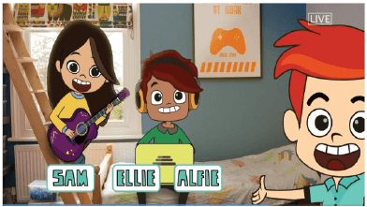
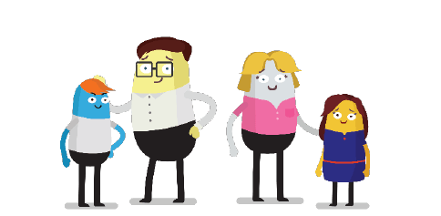
What is Thinkuknow?
Thinkuknow is the education programme provided by NCA-CEOP.
Thinkuknow offers resources for different audiences:
4-7
8-10
11-13
14+
Parents and Carers
Resources for those with special educational needs and disabilities (SEND)
Visit www.thinkuknow.co.uk for information and advice
Notes:
Thinkuknow is the education programme from NCA-CEOP. It provides professionals with resources to teach children and young people about sexual abuse online and covers the following age ranges: 4-7, 8-10, 11-13, 14+ and also for children with special educational needs and disabilities. Thinkuknow includes films, animations, websites, presentations and lesson plans to enable professionals to explore difficult and sensitive issues safely with children and young people.
Thinkuknow provides information and advice for parents and carers to help build their confidence and knowledge in protecting their children online, as well as to parents and carers supporting children who are victims of sexual abuse and exploitation. This presentation is part of the Thinkuknow package for parents and carers. Parents should visit www.thinkuknow.co.uk/parents for further information and advice.

Slide 4
Talk to your teenager
Find a good time and place
Think about how you are going to introduce the subject
Explain any worries you may have
Where do they go online?
What do they like?
What don’t they like?
Make sure they know they can come to you
Listen. Don’t judge. Learn…
Notes:
Talk to your teenager. The best way you can protect your child is to establish a positive relationship with them around their life online. Talk to them – not just once, but have ongoing conversations as part of your family life. As young people grow older, they understandably seek more autonomy and privacy in all aspects of their lives, and so it is important for you to remain engaged but to express that you trust them and for your involvement in their online life to be reflective of their age and maturity.
Find a good time and place. Pick an opportunity when you know you’re not going to be interrupted and you are both going to feel comfortable and have enough time, without turning it into one of those ‘special talks’ moments.
Think about how you are going to introduce the subject. You could mention a recent news story or just explain why you would like to talk to them about something.
Explain to them any worries you have. Your teenager might think that you are getting worried for no good reason, but if you explain why something is troubling you they will understand why you want to talk to them. Tell them if it is something you have read about or seen their friends doing.
Listen. Don’t judge. Learn. Find out more about what they encounter online - what they are doing, where they go, what they like and don’t like. Parental engagement in the positive aspect of being online and not just the risky things will help your child to talk more openly about their internet use, including anything that worries them.
The most difficult conversations can be made easier if your child understands that you care about them and whatever the outcome you will love them just as much. One of the biggest barriers to young people seeking help if something goes wrong online is the fear of being blamed, getting into trouble, and suffering repercussions (such as tech being taken away). Make sure they know that they can come to you for help if they are ever worried and that they won’t get into trouble. Young people who are banned from going online, or who feel that what they are doing is wrong, are less likely to ask for help and that makes them less safe.
This is not on the slide but an important point to raise. Parental controls - Controls are an important first step to helping to protect your child online, but they are not a single solution to staying safe; talking to your children and encouraging responsible behaviour is critical. For detailed guidance on all the different types of control, you can use this online tool from Internet Matters. This gives you the chance to set up a personalised list of the controls used in your home on all your different devices. There is also advice on how to use all the various controls, with videos and step-by-step instructions.
Recommend that parents and carers visit www.thinkuknow.co.uk/parents to read advice on how to support their child online.

Slide 5
The World Changes. Children Don’t.
Notes:
Insert video file to slide - ‘The World Changes. Children Don’t’
‘The World Changes. Children Don’t’ is a video made by NCA-CEOP for parents and carers. It shows what Shakespeare's story of Romeo and Juliet would look today with the influence of technology in relationships.
The point of the video is to demonstrate that young people haven’t changed, young people are still doing all of the same things adults did when they were young, but in new ways. Social media has changed the way young people communicate but their curiosity about friendships and relationships remains the same. Having a supportive parent or carer can make all the difference in helping children explore these themes as safely as possible.
Talking about relationships and the internet with young people can feel daunting, but it is important to remain balanced and communicate that you understand. Technology has become such an integral part of young people’s love lives, and young people have said they want adults to understand the positive role it can play in love and relationships. Young people have said they are less likely to go to their parents for advice if they feel their parents only portray a negative and risky role of the internet in relationships. Thinkuknow has a lots of advice and resources to help parents and carers have these conversations. Recommend that parents and carers visit www.thinkuknow.co.uk/parents to read advice on how to support their child online.

Slide 6
Understanding apps and games
Sharing
Chatting
Viewing
Friending
Notes:
Parents and carers have told NCA-CEOP that they can feel overwhelmed by the internet. The emergence of new apps and games every day can make the internet feel vast and ever-changing, but the reality is that there are actually only a limited number of functions that apps and games can have.
NCA-CEOP recommend using a simple technique of breaking down an app into its key functions of ‘Viewing, Sharing, Chatting, Friending’, and asking some simple questions in order to gain a better understanding of how the app works.
Viewing - What content can they see? Is it age appropriate? What filtering/privacy settings can be utilised? The internet provides lots of opportunities for young people to learn and gain information and support, but it is a public and open place, one where anybody can post and share content. Unfortunately it can be easy for children to come across inappropriate, sexual, violent content online. Most apps and games (but not all) include privacy and security settings that allow you to control what content can be seen and shared. In addition, tools such as parental controls and filters can help to manage a child’s online activities and what they are exposed to, however these are never totally fail-safe. What is vital is open and ongoing conversations with young people about what they see online, and making sure they are that they can talk to an adult if they see anything online that upsets them.
Sharing – What are they sharing and who are they sharing it with? A key part of our education with children and young people should be focused on talking to them about what they share online. It’s important that we explore the motivations to share online and that an image/video should never be shared if you feel pressured, uncomfortable or blackmailed. We also want to encourage young people to look out for others by not sharing inappropriate content.
Chatting and Friending – Who are they friends with and what are they sharing? It is important for young people to think critically about who they talk to online, especially if they are asking to talk privately with them, and young people should always be advised not share too much personal information online, and never feel pressured to do something online that they don’t want to do. There are people online who will try to put pressure on young people and manipulate them, and it’s important to speak to teenagers openly and honestly about this. Most importantly, it is vital that they know that they can talk to a trusted adult if anything bothers or worries them.
Resources to support you to have these conversations with your child will be covered at the end of this presentation.
What apps should I be concerned about? There are no apps/games that are more or less dangerous or risky. People who want to groom children will use any sites or services which children and young people use. Age restrictions exist to make viewers aware of the type of content in a game or app, and it is important that parents and carers are educated on age restrictions. Games and apps enable children to share an incredible amount of information about themselves, have conversations with their friends and also potentially provide contact with people they don’t know. With this in mind, parents and carers should take age restrictions seriously.
Optional activity: Name some popular apps with the group. Ask attendees to tell you which apps/games their children like to use. Do they know how they work? What questions would they ask?

Slide 7
Sexual exploration online
Exploring friendships online can create opportunities for young people to gain support.
It’s natural for young people to start exploring their sexual feelings online.
Risk-taking is a normal part of growing up.
“I think a lot of difficult conversations can be easier by
Messaging ‘cos it’s easier to have a bit of time to think…Like, so you’re not really on the spot, you can just have a bit of time to think. And you can stay a bit more calm.” Young person, 14
“Being able to find people online is, like, an easy way to test the waters. To, like, experiment or to, like, reaffirm your own sexuality and stuff like that.” Young person, 15
Notes:
Sexual exploration online
Exploring relationships online can create opportunities for young people to gain support. As parents, it is important to focus on positives as well as any risk
It’s natural for young people to start exploring their sexual feelings online. This is part of their progression and young people will use the internet to explore their friendships and relationships.
Talking to new people online can feel exciting to young people, but they could be contacted by people who pose a risk to them. It is important to talk to young people about staying safe when chatting online. There is advice on how to have these conversations at thinkuknow.co.uk/parents
Remember, adolescents are more inclined to take risks - this is a normal part of growing up. They might be even more likely to take risks online as being online may give them the confidence to do and say things they might think twice about ‘in real life’. It is important to understand this and to talk to your child in a positive way, helping them to learn, explore and develop their identity online in a safe way.
The two quotes on the slide are from young people from Brook/NCA-CEOP research ‘Digital Romance’, 2017

Slide 8
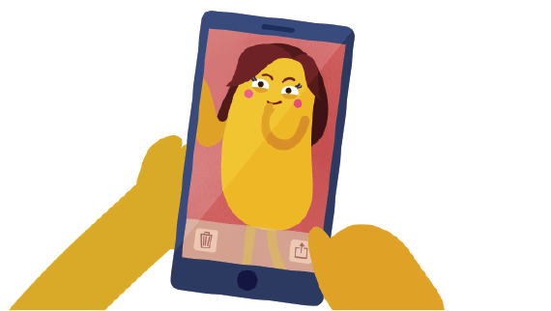
Sharing images
Young people may share naked or semi-naked images of themselves for a variety of reasons:
As part of a committed and trusting relationship
As a way to flirt with someone
For affirmation or seeking attention from someone they like
Because they feel other young people are doing it
For a joke
Because they have been pressured, manipulated or coerced into doing so
Notes:
Sharing of images
The slide details a range of contexts and motivations in which a young person may share a naked/semi-naked photo of themselves online.
As most young people spend an extended amount of time online, it is only natural that as they grow, they will start to explore relationships and sex online. This can be a positive experience if done safely and consensually, but of course it can also expose them to risks.
These motivations demonstrate a range of situations and contexts in which a nude photo may be taken. Some situations are more risky than others, and show how important it is to understand the context behind an image. If you are concerned that an image is a result of sexual abuse, report these immediately to your local police force (101 or 999 in an emergency), NCA-CEOP (www.ceop.police.uk) or the NSPCC.

Slide 9
Sexual abuse online
There are opportunities for adults to contact children and young people online, in order to harm them. They can use any part of the internet – games, social media, live streaming platforms etc.
Adults can create multiple online identities and even pretend to be children and young people themselves.
Adults can exploit young people’s natural curiosity by talking about sex and introducing harmful things.
Adults can pressure, intimidate and coerce children into doing things that they are not ready for. Increasingly children and young people are tricked into sexual activity over live video.
Notes:
Sexual abuse online
There are opportunities for adults to contact children and young people online. They can use any part of the internet – games, social media, live streaming platforms etc. They may send out multiple ‘friend requests’ or messages at random, target young people who they identify as particularly vulnerable (for example, by the things they post online) or may attempt to build a relationship via a game.
Adults can create multiple online identities and even pretend to be children and young people themselves. Others may be open and honest about who they are.
Adults can exploit young people’s natural curiosity by talking about sex and introducing harmful things. They may start with seemingly ‘innocent’ comments and build up to more sexual conversation and sending images and videos.
Adults can pressure, intimidate and coerce children into doing things that they are not ready for. Increasingly children and young people are tricked into sexual activity over live video. Talk to your child and ask them what they would do if someone made an inappropriate request online, give them the skills to respond and make sure they know that they can come to you.

Slide 10
#WhoisSam?
Notes:
Optional video – please watch before delivery. It is at your discretion whether you would like to include.
Insert video file to slide – WhoIsSam?
This short animation is narrated by a fictional character called Sam. It highlights the importance of parents and carers talking openly to their children about being safe online, about healthy relationships and encouraging them to speak out if anything happens online that worries them or doesn’t feel right. It is narrated by a fictional online offender called Sam, who targets children online and quickly builds trust with them.
After watching the video, highlight that online offenders can be anyone, not just the ‘type’ of person shown in the video. All children can be vulnerable and it is very important not to approach this from a perspective of ‘it won’t happen to someone I know’.

Slide 11
What can you do?
Talk to your child about their life online.
Make sure your child knows that they will never be blamed.
Don’t threaten to ban technology.
Practical steps you can take
Direct your child to age appropriate information about relationships and sex .
Report any concerns to local police, CEOP or the NSPCC.
Notes:
What can you do? There are a lot of practical things you can do to support your child to stay safe online.
Talk to your child about their life online. Talk to your child about what they are doing online, what they are enjoying, what they are learning and the new things they have discovered. Parental engagement in the positive aspect of being online and not just the risky things will help your child to talk more openly about their internet use, including anything that worries them.
Make sure your teenager knows that they will never be blamed. It is important not to blame your child if something goes wrong online.
Technology, flirtation, excitement and hormones are a powerful mix. This can make it hard for young people to think clearly about their actions online and to consider the possible consequences. Young people will take risks online, and they need to know that you will always give them calm and non-judgemental support. One of the greatest barriers to a child seeking help is the feeling that they have done something wrong. If your child is engaged in sexualised contact they might react in many different ways from excitement to distress, but they may also feel guilty. It is never a young person’s fault if they have been engaged in sexual chat by an adult. Remind your child that they will never be blamed and can always speak to an adult they trust if they are worried, no matter what may have happened.
Don’t threaten to ban technology. It can help to suggest taking a break from an app for a period of time. This can help them learn from what happened, rather than banning them from the internet all together. Technology can provide sources of support to young people and it is important not to restrict them from this, which could lead to them taking greater risks by accessing tech somewhere else.
Direct your child to age appropriate information about relationships and sex. For example from Thinkuknow, Brook, The Mix, Childline.
Report any concerns. If you have any concerns about online sexual abuse, report these immediately to local police (101 or 999 in an emergency), NCA-CEOP (www.ceop.police.uk) or the NSPCC.

Slide 12
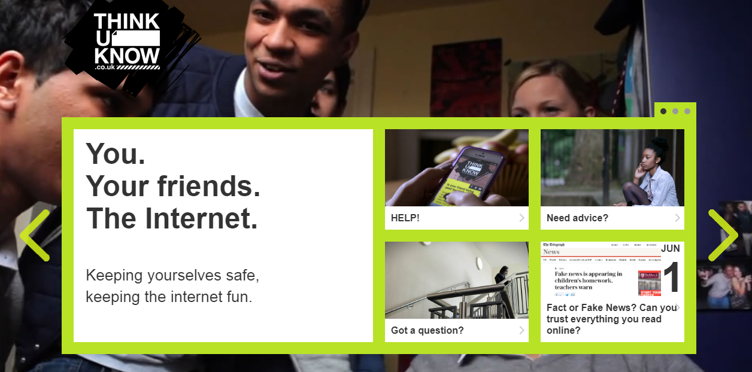
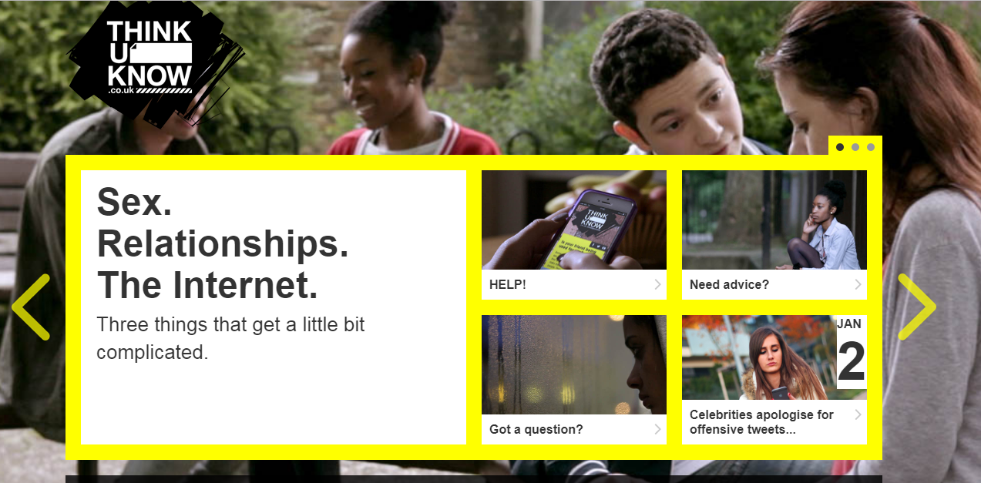
Thinkuknow teen websites
Notes:
The teen Thinkuknow websites (11-13 and 14+) help young people to develop healthy approaches to friendships, relationships, sex and the internet. It teaches them to identify negative or unhealthy behaviour, respond with resilience, and know where to go for help if they ever feel anxious or threatened online or in a relationship. They cover topics such as: consent, healthy and unhealthy relationships, pressurising and threatening behaviours online, and reporting abuse to NCA-CEOP.
Encourage parents to take a look at the teen websites following the session and using them to start a conversation with their teenager.

Slide 13
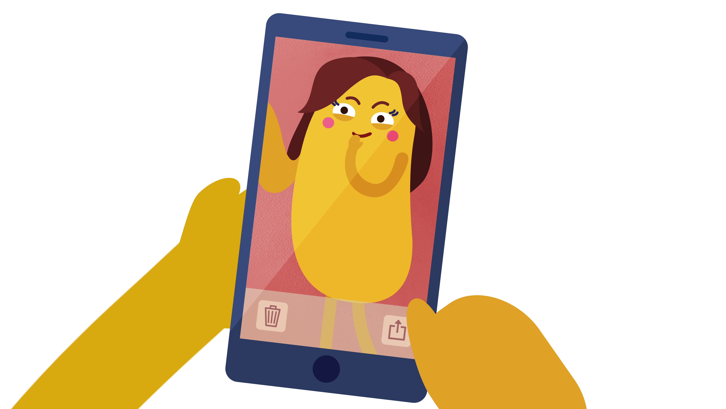
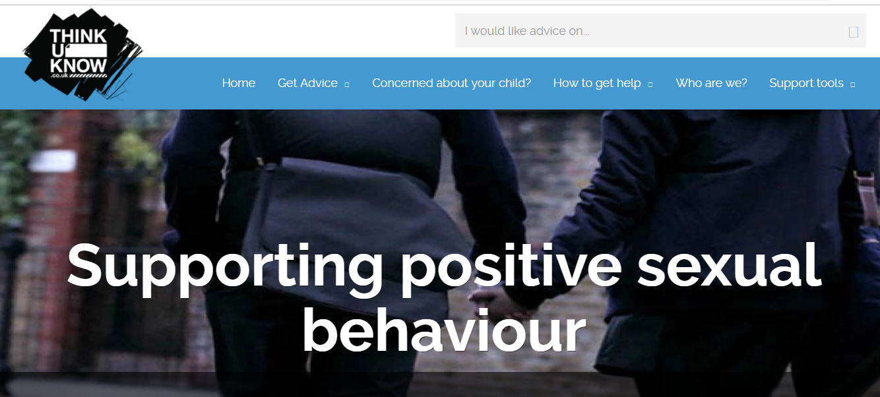
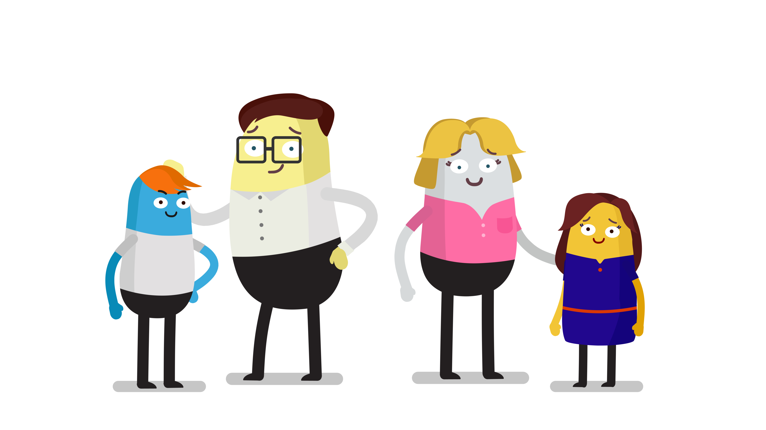
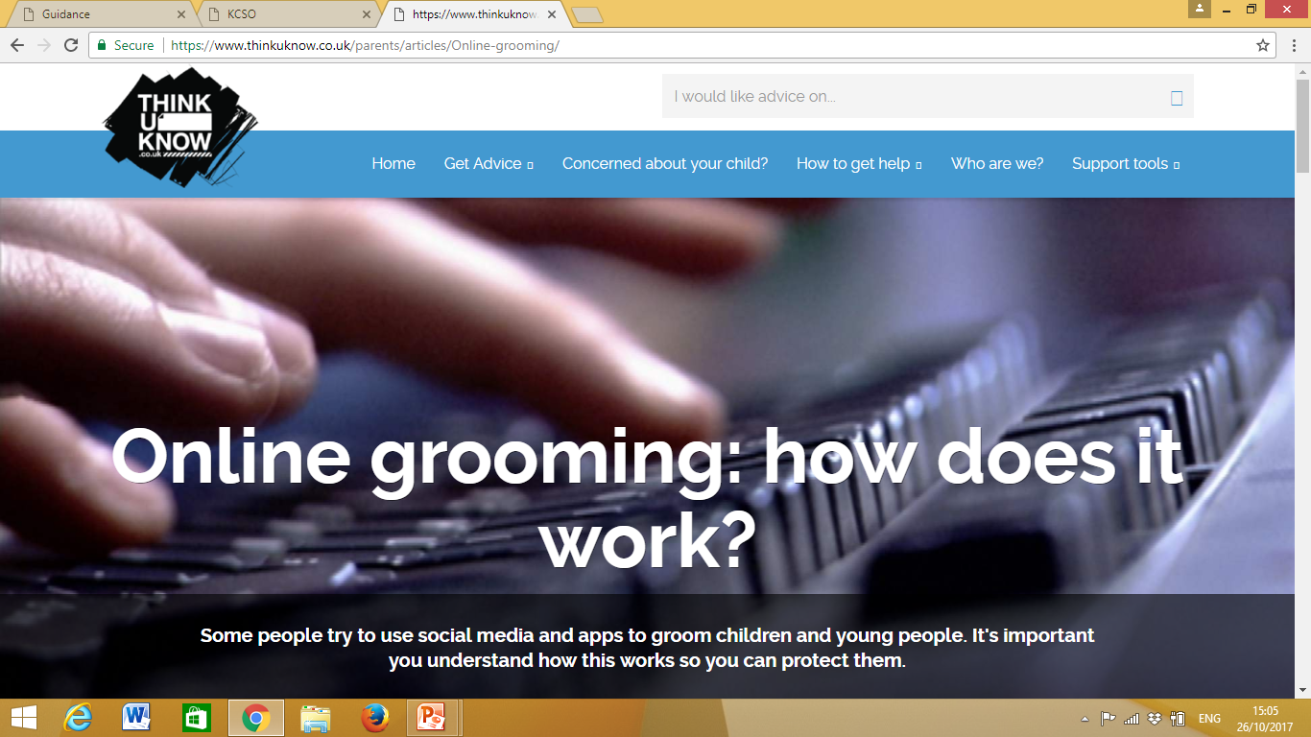
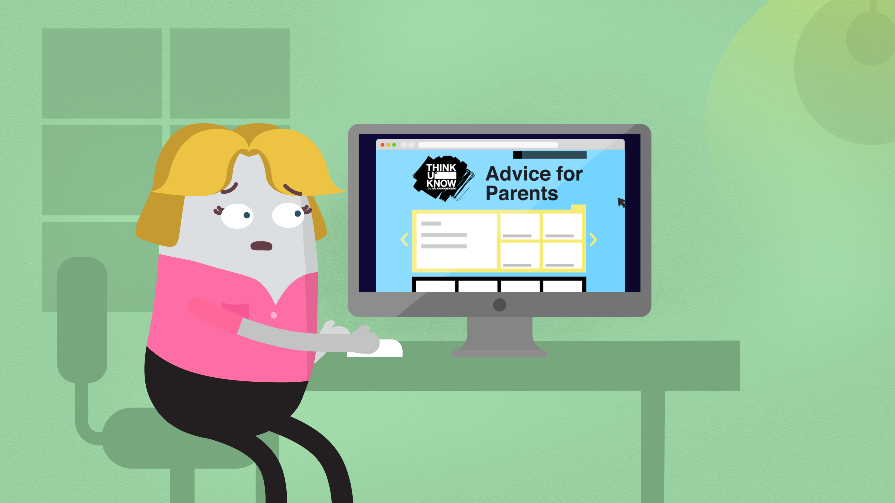
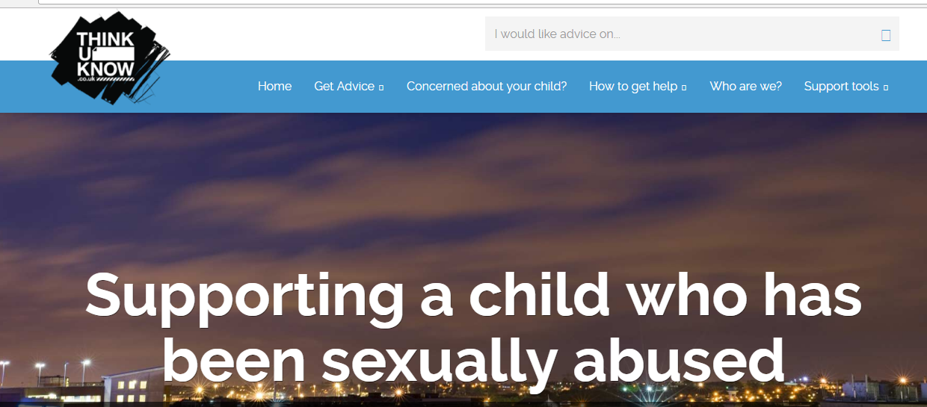
Resources for Parents and Carers
Notes:
Resources for parents and carers
Nude Selfies: What Parents and Carers Need to Know is a series of three animated films for parents and carers. The films offer advice on how to keep children safe from the risks associated with the sharing of nude and nearly nude images. The films cover young people's motivations for sending nude images, responding constructively to an incident in which a child has shared a nude image, and identifying risky behaviours or situations. Encourage parents to watch these on YouTube following the session.
Thinkuknow Parents and Carers website - The Thinkuknow Parents and Carers website contains a wealth of information and advice for parents and carers on keeping their children safe online. The website covers topics such as: having a conversation with your child, using parental controls, understanding live streaming and supporting children who have been sexually abused. It is divided into three sections:
I need to report an incident – for information and support when something has already happened to a child or young person
I’m concerned about my child – for information and support when there are concerns about a child or young person
I’d like to understand more about keeping my child safe – for preventative information and advice on keeping children safe online

Slide 14
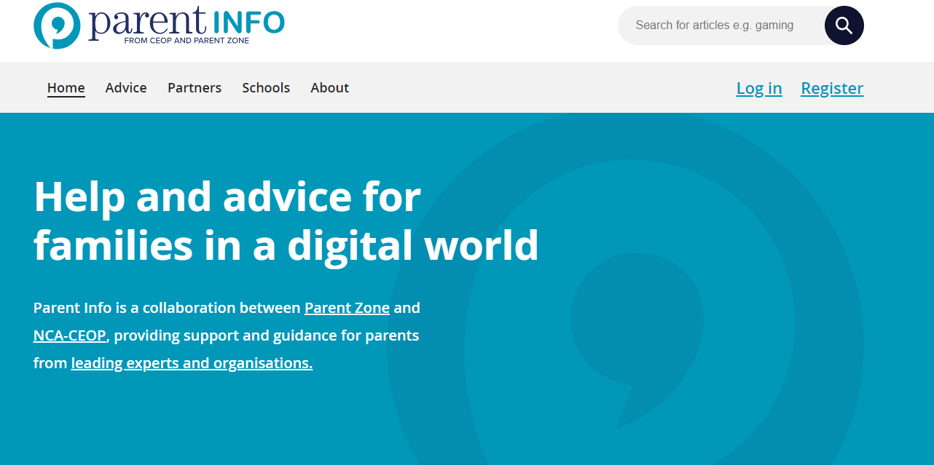
www.parentinfo.org
Notes:
Parent Info (www.parentinfo.org) is a partnership project between NCA-CEOP and the parent organisation Parent Zone. It’s a website and advice service for parents and carers, which aims to build the resilience of their children through articles, tips and advice. Articles are written by expert organisations on a range of different topics, covering every issue amplified by the internet. It is divided into the following categories:
Games, apps and tech
Parenting
Safety and settings
Relationships and sex
Education and the future
Health and wellbeing

Slide 15
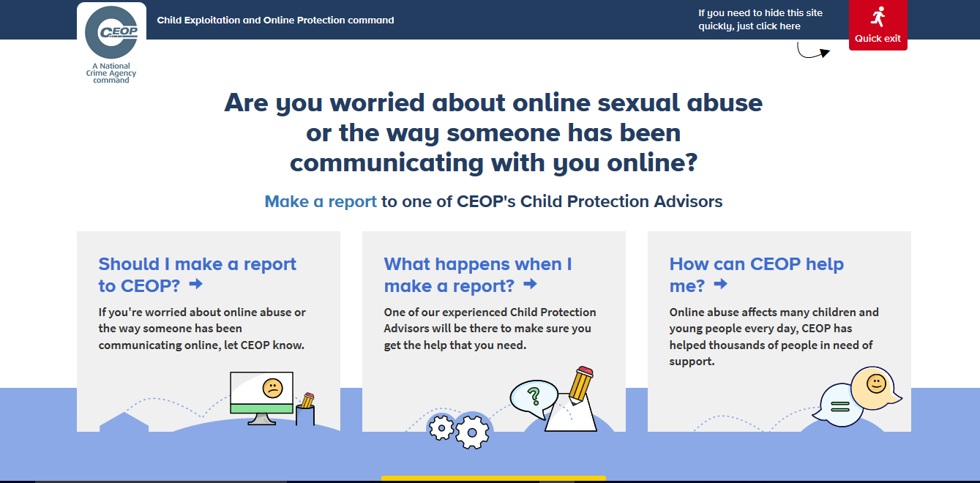
Reporting to NCA-CEOP – www.ceop.police.uk
Notes:
Note to presenter: Before delivering this section, familiarise yourself with CEOP’s website and advice pages by visiting www.ceop.police.uk.The website has information on:
When to report to CEOP
What happens when a report is made to CEOP
How CEOP can help
The CEOP website is known as the ‘safety centre’ as it hosts an online reporting tool, made specifically for children and young people in order for them to report concerns relating to online sexual abuse and exploitation directly to CEOP. Parents and carers can also report to CEOP if they are worried about a child or young person in their care. The buttons on the right hand side of the screen link to the safety centre. The Click CEOP button can be embedded on external websites, such as a school’s website (if you have the button on your organisations website tell audience where this can be found). CEOP takes all reports seriously. The reporting form is designed to be as accessible as possible by children and young people.
It is not possible to report to CEOP anonymously. CEOP advise any urgent reports where a child/young person is in immediate danger should be reported to the local police force where the child/young person is located.
Cyberbullying should not be reported to CEOP as it falls outside their remit of CSAE. Children and young people should be directed to speak to an adult they trust, and/or referred to Childline, if they would like to speak to someone about how they are feeling.

Slide 16
Staying up to date:
@CEOPUK
ClickCEOP
www.thinkuknow.co.uk
www.thinkuknow.co.uk/parents
www.ceop.police.uk/safety-centre
Notes:
For more information on Thinkuknow please visit – www.thinkuknow.co.uk
The NCA-CEOP ‘safety centre’ and reporting tool can be found at www.ceop.police.uk
You can also keep up to date by following NCA-CEOP on Twitter or Facebook.

