Slide 1
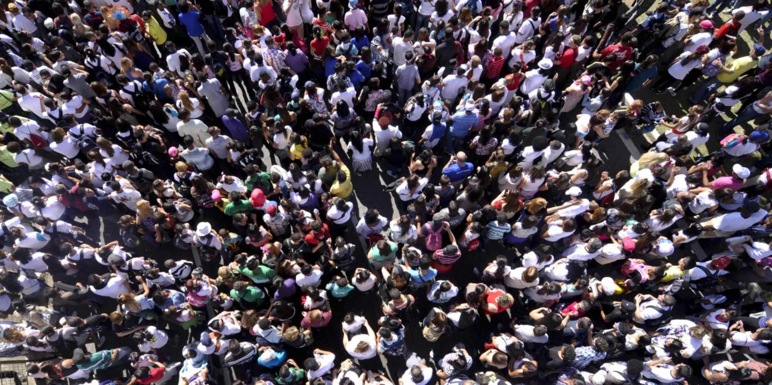
What I have learnt about children’s rights..
#Human Rights Day Tuesday 10th December 2019

